Slide 1


Ear-AR: Indoor Acoustic Augmented Reality
on Earphones
Zhijian Yang,
Yu-Lin Wei, Sheng Shen, Romit Roy Choudhury
Notes:
Hello every one. My name is Zhijian Yang. Today, I’m going to present our work Ear-AR: indoor acoustic augmented reality on earphones. This is the joint work with my labmates Yu-Lin and Sheng, and our advisor Romit. We are from University of Illinois, Urbana Champaign.

Slide 2
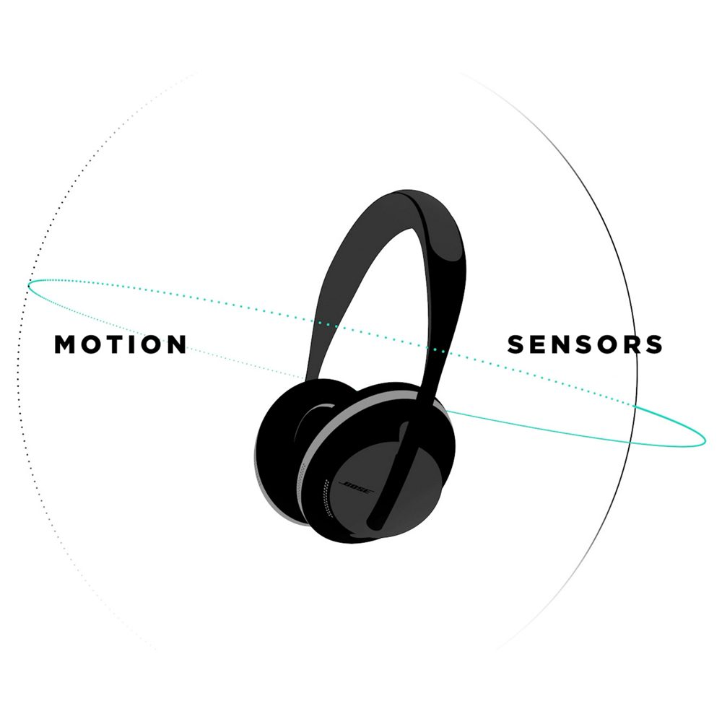
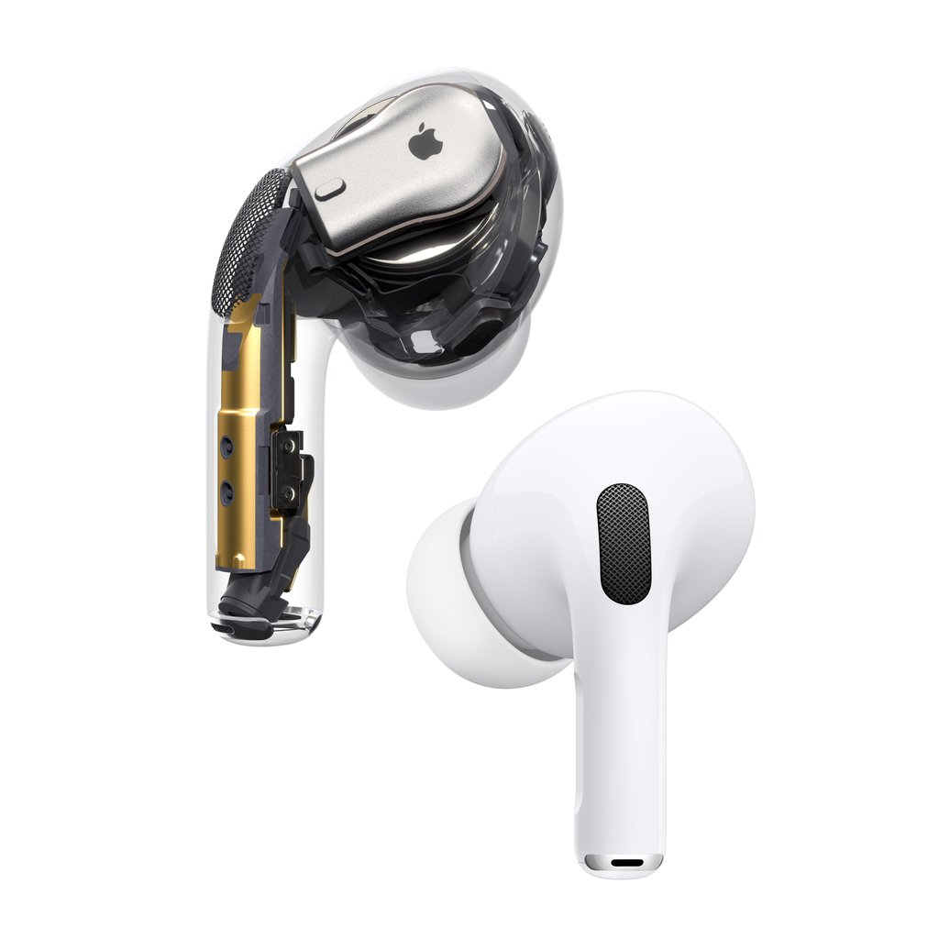
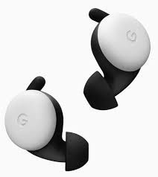
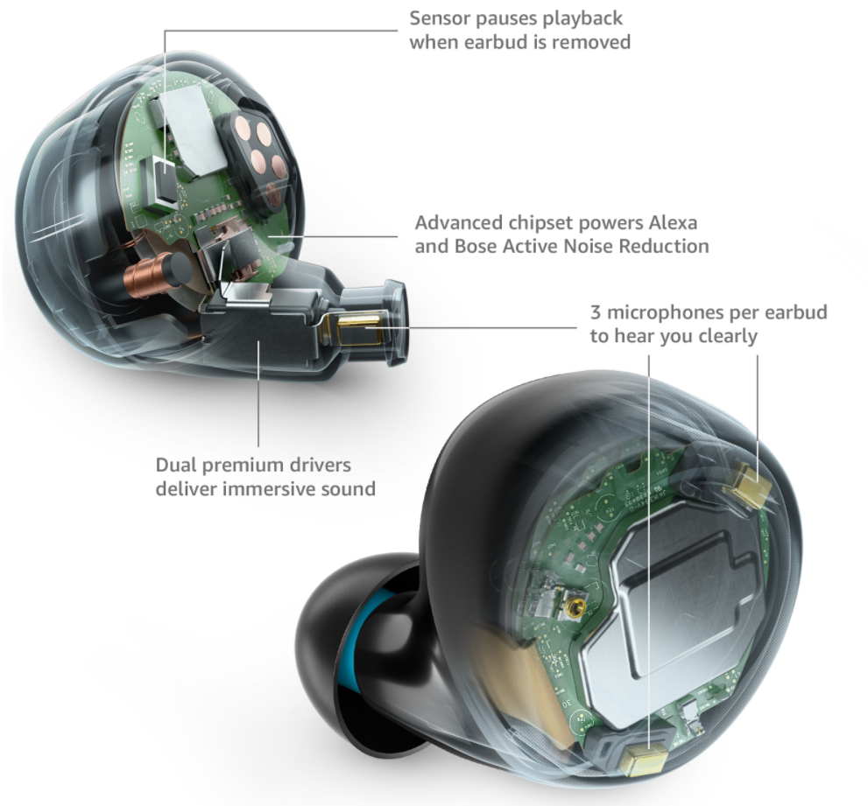
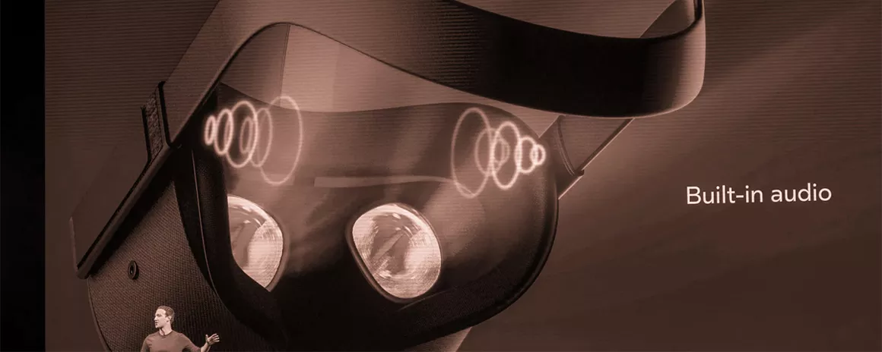
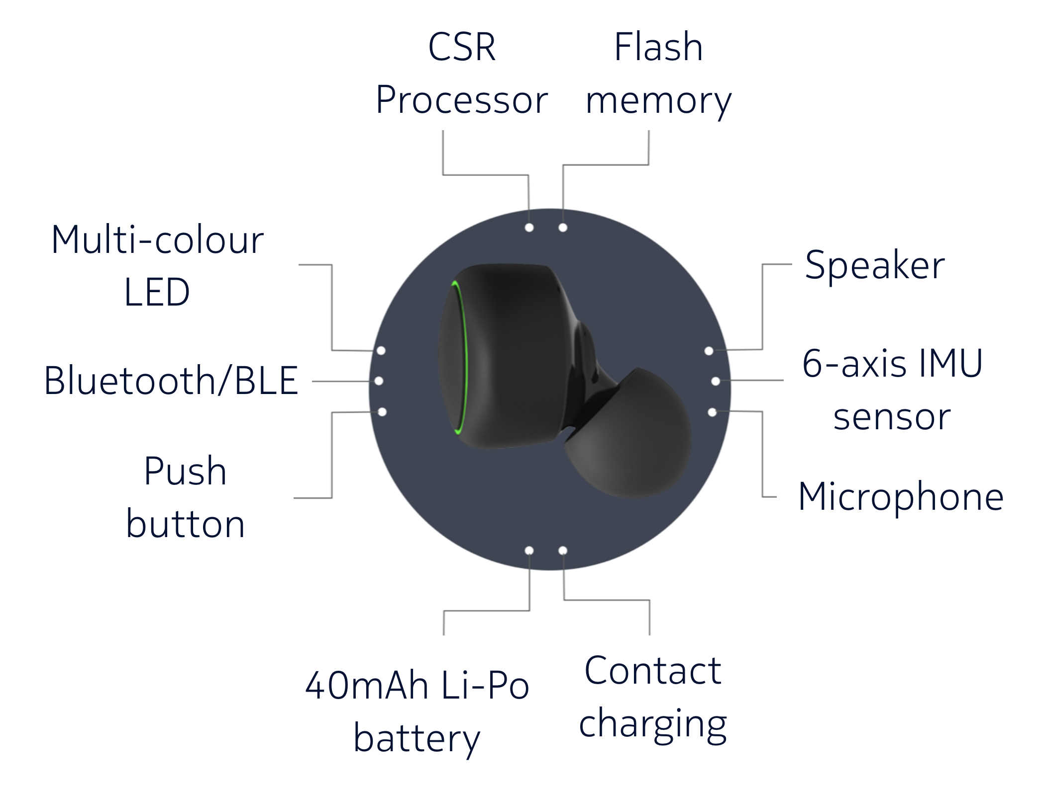
Smart Earphones are Booming
Notes:
Nowadays, smart earphone is a booming market. Lots of industrial companies are doing acoustics research and rolling out smart earphone products. Apple has their airpods, google has pixel buds, amazon has echo buds, and bose of course, has a lot of acoustics products. Facebook and oculus has been working on their spatial audio for years for their oculus products and nokia bell lab has released esense, a research platform for the research community to develop new applications for smart earphones.

Slide 3
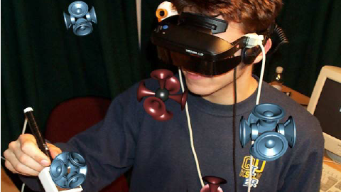
Acoustic Augmented Reality
Notes:
This paper looks at one of new application enabled by smart earphones, acoustic augmented reality.

Slide 4

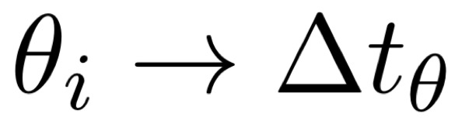
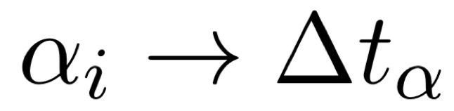
Human brains can infer sound geometry
Different propagation
delays at two ears
Binaural Ability
Notes:
Human brain has the ability to infer sound geometry. When a sound source is at angle theta relative to the human ear, it creates a delay of t theta at two ears. For another sound coming from angle alpha, it creates a different delay delta t alpha. By analyzing the time difference of arrival at two ears, human can tell the sound source direction. This ability is called binaural ability.

Slide 5
Possible to artificially create geometric sounds through earphones
Different propagation
delays at two ears
Inject artificial delays as if sounds coming from a specific direction
Binaural Sound
Notes:
This means, it is possible to … by injecting …
We call this artificially created sound binaural sound.

Slide 6
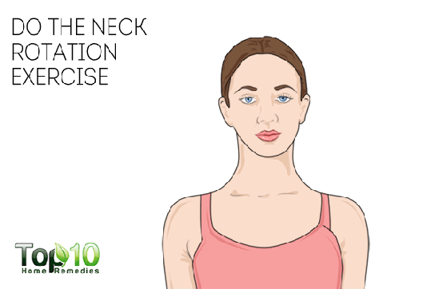
In fact, possible to measure head motion … so sound source can be fixed in 3D location
3D Gazing
Direction
Notes:
In fact, it is also possible to track human head rotation, so that we can render the binaural sound in real time to compensate for the head turning so that the binaural sound come from a fixed direction in the physical world.

Slide 7
Leverage binaural sound (from the earphone) to enable new applications …
This paper: Acoustic Augmented Reality (AAR)

Slide 8


Airport Navigation
Follow me to your gate
Shorter check-in here
Starbucks cafe
Notes:
Let’s imagine you are in an airport rushing towards your gate, AAR would offer great value in navigating you to your gate, quick and elegant.
==============
Or if you are in an airport rushing towards your gate, it would be desirable if there is a vitual guide navigating you through your earphone so that you can avoid the hassel of taking a suitcase and pulling out the phone frequently to see the routes.

Slide 9

Museum Narrator
XXXX
XXXX
Notes:
Or when you are visiting a museum, and you want some audio narrator to describe the paintings to you. When you look at painting A, it tells you the description and when you walked away and looked at painting B, narrative audio will also change to painting B. Moreover, the audios are in the format of binaural audio so that it sounds just like it comes from the actual painting. This would improve the experience of such a museum visit.

Slide 10
Key Research Question:
Design the binaural sound in the earphone so it appears to arrive from the right relative location (w.r.t. the earphone user)
Localization Module
(indoor)
Head Tracking Module
Binaural Audio Module

Slide 11



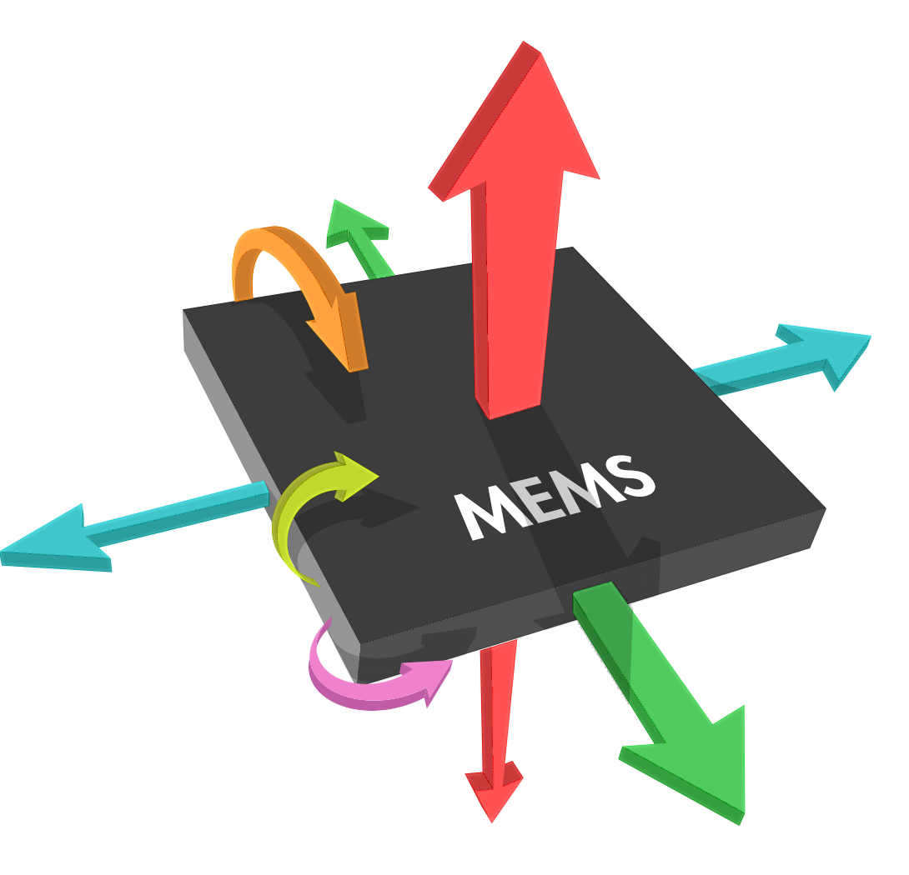

Indoor localization is a widely studied research topic
Minimal Infrastructure
Easy to set up
Low power
Accurate
Difficult to achieve all
Notes:
Of course there have been a lot of work on indoor localization, but it is still difficult to find a solution that has minimal infrastructure requirement, easy to set up, low power and accurate.

Slide 12


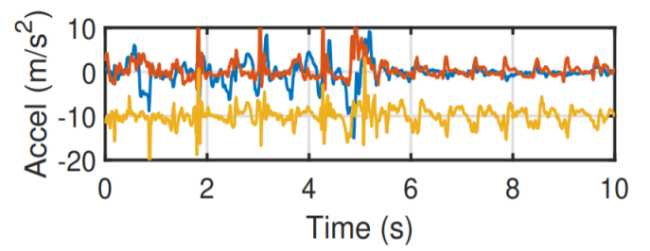
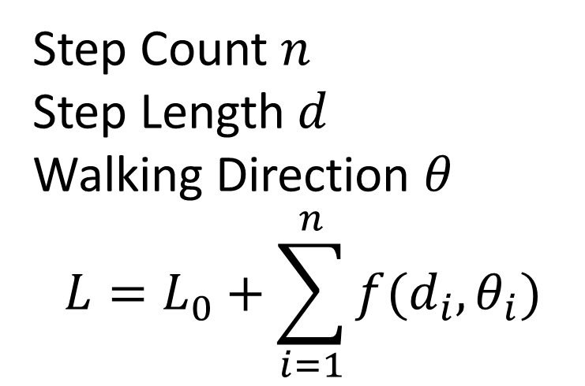




IMU dead reckoning is closest to our requirement
$$√$$
Minimal Infrastructure Requirement
Easy to set up
Low power
Accurate
Random Limb Movement Pollutes Signal
$$√$$
Step Count $n$
Step Length $d$
Walking Direction $θ$
$$L=L_{0}+\sum_{i=1}^{n}{f(d_{i}, θ_{i})}$$
$$√$$
$$×$$
Notes:
IMU dead reckoning seems the closest to our requirement but it is not accurate. IMU dead reckoning involves pulling out step count, step length and walking direction from the IMU signal. However, previous researchers mainly pull out the signal from phone or smart watch IMU, which can be easily polluted by random limb movements, making the signals quite noisy. Lead to inaccurate localization.

Slide 13

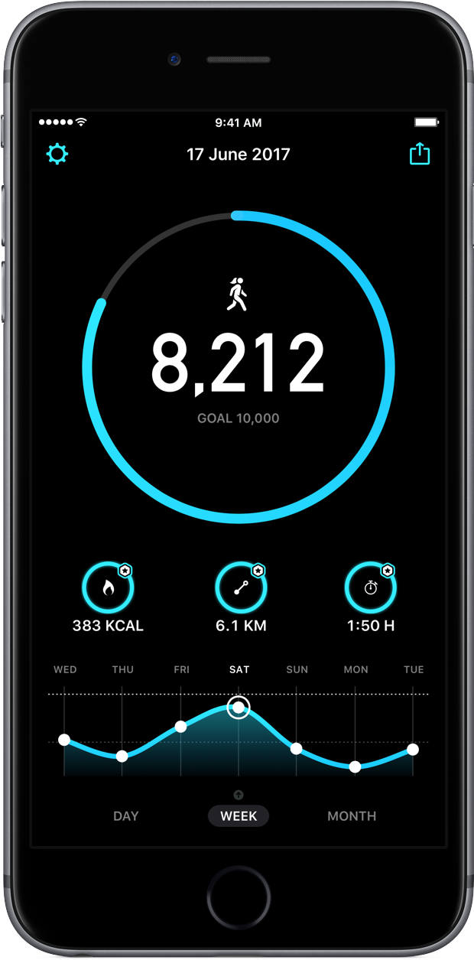
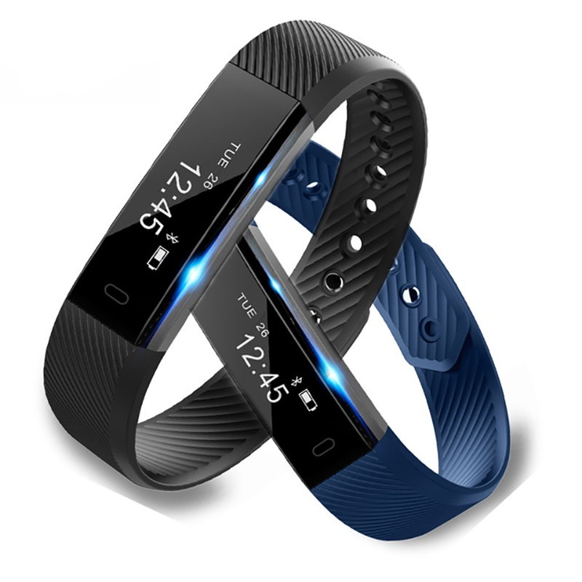
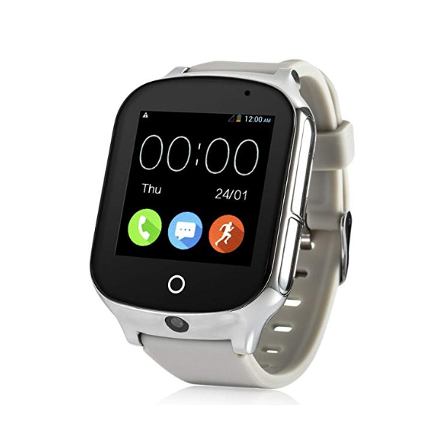
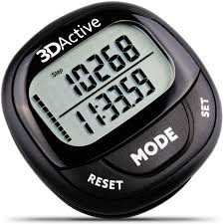
Previous works use sensors on lower body
Lower body
Notes:
One observation, however, is that most past works rely on IMU that is at the lower part of body, which will be polluted by all kinds of random body movements.

Slide 14
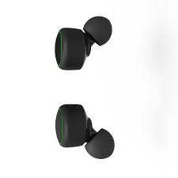




Can we leverage IMU in smart earphones?
Lower body
Notes:
We now have smart earphone IMUs, which have a unique upper body mounting point. Can we leverage this IMU to do better localization?

Slide 15
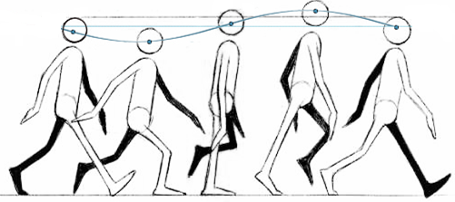
Key Opportunity: Body is a “Filter”
Notes:
It turns out, the unique mounting point of on ear IMU offers a key opportunity: body acted as a filter, filtering out all the random motions, making the signal much cleaner.

Slide 16
Key Opportunity: Body is a “Filter”
Interference from hand, arm, legs filtered by body when signal propagates up to the ear …
Notes:
Interference from hand, arm, legs are all filtered by body when signal propagates up to the ear. This makes localization more robust.

Slide 17
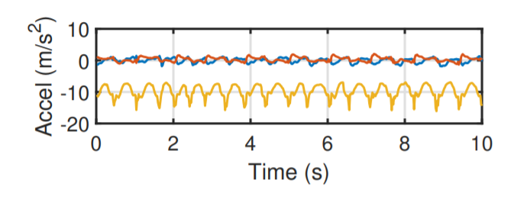
Key Opportunity: Body is a “Filter”
Notes:
To give you an intuitive comparison, the upper graph shows the earphone IMU signal while the lower graph shows the phone IMU signal. It is evident that the ear IMU signal is much cleaner. Leveraging this cleaner signal, we can do much better localization for AAR.

Slide 18
Dual IMU dead reckoning
Ear IMU
Ear-AR Localization Algorithm
Phone IMU
Better Localization
Motion
Model
Now let me dive deep into Ear-AR dead reckoning algorithm…
Notes:
We develop the Ear-AR algorithm that takes advantage of the clean ear IMU signal. We jointly put ear imu, phone imu and human motion model as input, the output is a much better IMU localization result.

Slide 19
1
Step Count
This is the easiest of three.
Ear IMU shows clear peak.
Solution: count how many peaks in the time domain.
Notes:
Let’s first look at step count. Step count is the easiest of the three. Earphone IMU captures clear sinusoidal acceleration signal. We basically count how many peaks there are in the signal to estimate step count.
========
Due to no random limb movement polluting, step count on earphones is more robust than on phone or watch IMUs.

Slide 20


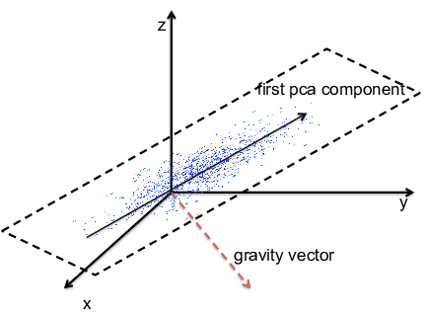
2
Walking Direction
Let’s first look at a few existing solutions
Indoor Magnetic Interference
Requires Phone in Hand
Affected by Random Motion
Notes:
The second problem of dead reckoning is estimating walking direction theta. Let’s first look at a few current solutions.
People have been using magnetometer for walking direction estimation, however, due to the indoor magnetic field interference, we cannot use magnetometer.
Other past works assume user is always holding phone in hand in front of them, and they will do gyroscope integration and treat the phone’s heading direction as walking direction.
This is however not suitable for AAR, because users are not likely to constantly hold their phone in hand when using AAR system. In fact, the reason why using AAR is to get rid of looking at the phone.
There are also some researchers who use the opportunity that the direction in which people are walking has the largest variance in acceleration. They identify the first PCA direction vector on the horizontal plane as walking direction. This is also not too reliable given users may be using the phone, causing additional accelerations.

Slide 21
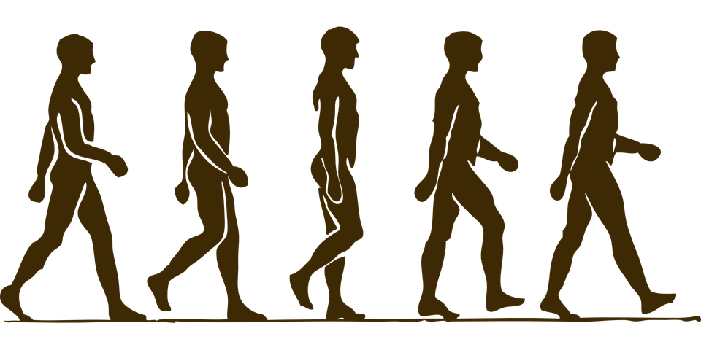
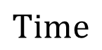
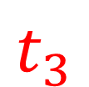

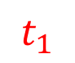
2
Walking Direction
Earbud
Smart phone
$$t_{1}$$
$$t_{2}$$
$$t_{3}$$
$$Time$$
Notes:
Now let me present our method of identifying walking direction. Let’s first assume the phone is in pocket. This graph shows different phases of human walking. We can see that when the leg where the phone is on is on the ground, the smartphone is rotating when the user is walking. The rotation axis is actually perpendicular to the walking direction.

Slide 22
2
Walking Direction
Earbud
Smart phone
$$t_{1}$$
$$t_{2}$$
$$t_{3}$$
$$Time$$
Notes:
Now let me present our method of identifying walking direction. Let’s first assume the phone is in pocket. This graph shows different phases of human walking. We can see that when the leg where the phone is in is on the ground, the smartphone is rotating when the user is walking. The rotation axis is actually perpendicular to the walking direction.

Slide 23
2
Walking Direction
Earbud
Smart phone
$$t_{1}$$
$$t_{2}$$
$$t_{3}$$
$$Time$$
Notes:
Now let me present our method of identifying walking direction. Let’s first assume the phone is in pocket. This graph shows different phases of human walking. We can see that when the leg where the phone is in is on the ground, the smartphone is rotating when the user is walking. The rotation axis is actually perpendicular to the walking direction.

Slide 24
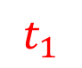
2
Walking Direction
Earbud
Smart phone
$$t_{1}$$
$$t_{2}$$
$$t_{3}$$
$$Time$$
Notes:
Now let me present our method of identifying walking direction. Let’s first assume the phone is in pocket. This graph shows different phases of human walking. We can see that when the leg where the phone is in is on the ground, the smartphone is rotating when the user is walking. The rotation axis is actually perpendicular to the walking direction.

Slide 25
2
Walking Direction
Earbud
Smart phone
$$t_{1}$$
$$t_{2}$$
$$t_{3}$$
$$Time$$
Notes:
Now let me present our method of identifying walking direction. Let’s first assume the phone is in pocket. This graph shows different phases of human walking. We can see that when the leg where the phone is in is on the ground, the smartphone is rotating when the user is walking.

Slide 26






2
Walking Direction
Earbud
Phone rotation axis is always perpendicular to walking direction.
Smart phone
$$t_{1}$$
Walk Direction $\vec{d}$
$$t_{2}$$
Walk Direction $\vec{d}$
$$t_{3}$$
Rotation Axis $\vec{V}$
Rotation Axis $\vec{V}$
Notes:
One key observation is that the rotation axis of the phone is actually perpendicular to the walking direction.
This gives us the key opportunity.

Slide 27
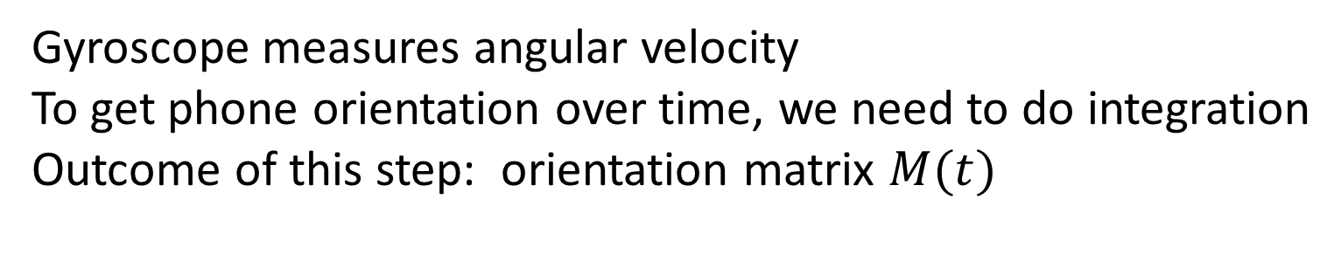
2
Walking Direction
IMU data
Gyro Integration
Step segmentation
Find Rotation Axis
Find Walking Direction
Gyroscope measures angular velocity
To get phone orientation over time, we need to do integration
Outcome of this step: orientation matrix $M(t)$
Notes:
Then let me introduce the detailed pipeline of how we implement this idea. The first step is to do gyroscope integration. This is because, gyroscope measures angular velocity not orientation. To get phone orientation over time, we need to do integration. We use the format of orientation matrix M(t) to represent the integration result, which shows the orientation of phone at any given time.

Slide 28
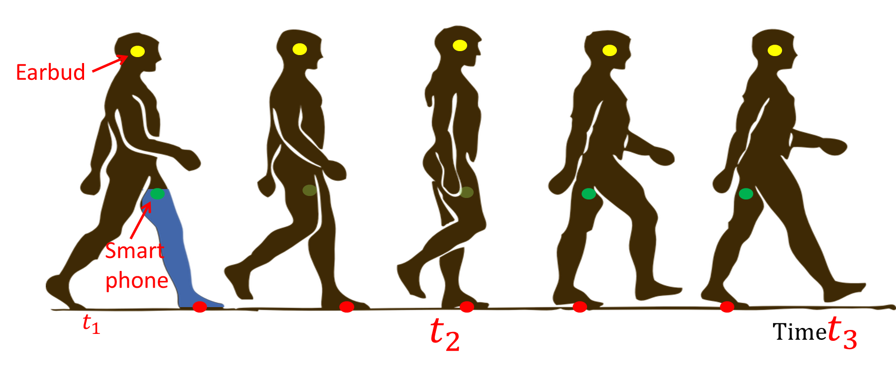

2
Walking Direction
IMU data
Gyro Integration
Step segmentation
Find Rotation Axis
Find Walking Direction
We need to find step boundaries $t_{1}$ and $t_{3}$.
Notes:
The second step is to do step segmentation. We need to find the step boundaries t1 and t3, because this is the period where the leg rotation which we are interested in is happening.

Slide 29

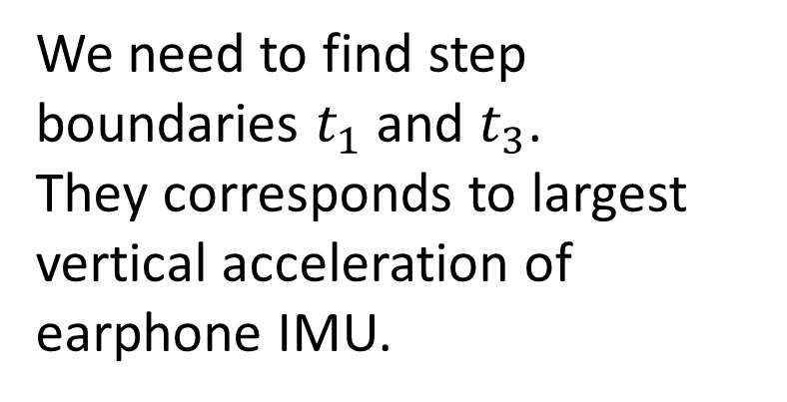
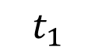
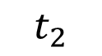


2
Walking Direction
IMU data
Gyro Integration
Step segmentation
Find Rotation Axis
Find Walking Direction
$$a$$
$$t_{1}$$
$$t_{3}$$
$$t$$
$$t_{2}$$
We need to find step boundaries $t_{1}$ and $t_{3}$.
They corresponds to largest vertical acceleration of earphone IMU.
Notes:
To do this, we need the help of earphone IMU data. The sinusoid graph shows the ear IMU vertical acceleration over time. We can see that the starting boundary t1 and ending boundary t3 actually corresponds to the position where the earphone is at the lowest point, so exhibits the largest upward acceleration. By finding the peaks in vertical ear IMU acceleration, we are able to do step segmentation and find step boundaries t1 and t3.

Slide 30
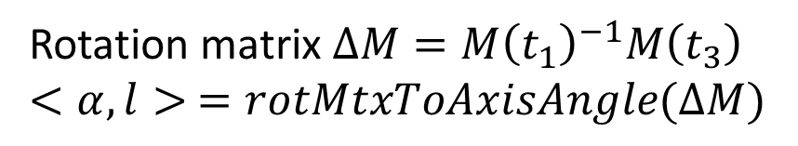
2
Walking Direction
IMU data
Gyro Integration
Step segmentation
Find Rotation Axis
Find Walking Direction
Rotation matrix $ΔM=M{\left(t_{1}\right)}^{−1}M\left(t_{3}\right)$
$$<α,l> =rotMtxToAxisAngle(ΔM)$$
Notes:
After that, we need to find the rotation axis from t1 to t3. We first write out the rotation matrix from t1 to t3, which is delta M = M(t1)^-1 times M(t3). Then convert the rotation matrix into rotation axis and angle representation. The output l is the rotation axis we want to find.

Slide 31
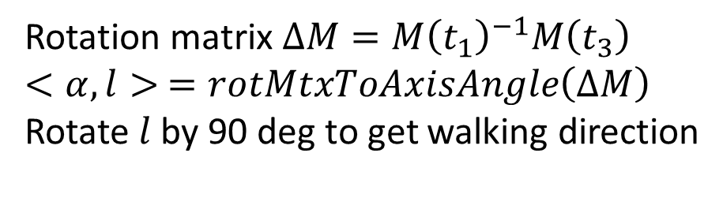
2
Walking Direction
IMU data
Gyro Integration
Step segmentation
Find Rotation Axis
Find Walking Direction
What if phone not in pocket?
Rotation matrix $ΔM=M{\left(t_{1}\right)}^{−1}M\left(t_{3}\right)$
$$<α,l> =rotMtxToAxisAngle\left(ΔM\right)$$
Rotate $l$ by 90 deg to get walking direction
Notes:
Finally, rotate l by 90 degrees and we find the walking direction. Remember, we are considering phone in pocket. Then one natural question people may ask is, what if phone is not in pocket?

Slide 32
2
Walking Direction – phone not in pocket
IMU data
Global Projection
Step segmentation
Find PCA Direction
We will do PCA on earphone horizontal acceleration.
The direction that has largest variance gives walking direction.
Much better than PCA on phone/watch IMU.
Notes:
When phone is not in pocket, we will rely on the doing PCA on earphone acceleration to get walking direction. (The direction that has the largest variance gives walking direction.) For the interest of time, I will not go into the details. This is a standard technique, however, because we are doing this on ear IMU, which has a much cleaner signal than phone/watch IMUs, we are able to achieve better result compared with past works.

Slide 33
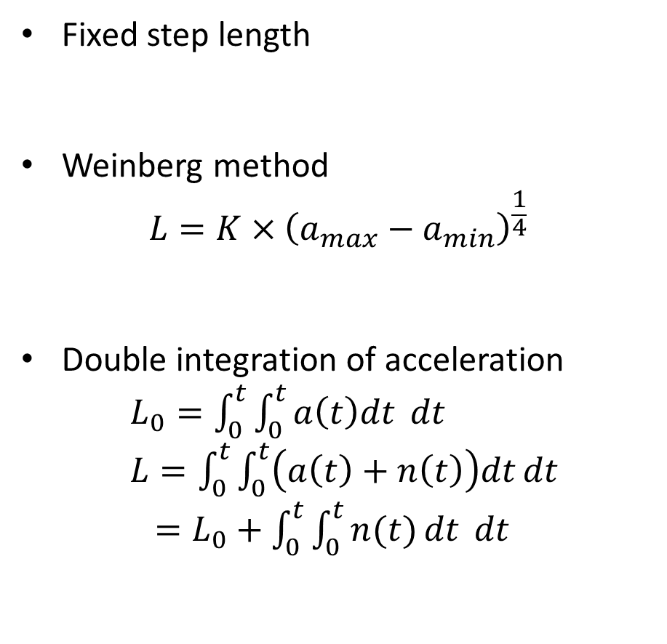
3
Step Length
Not a good assumption
Fixed step length
Weinberg method
$$L=K×{\left(a_{max}−a_{min}\right)}^{\frac{1}{4}}$$
Double integration of acceleration
$L_{0}=\int_{0}^{t}{\int_{0}^{t}{a\left(t\right)dt} dt}$
$L=\int_{0}^{t}{\int_{0}^{t}{\left(a\left(t\right)+n\left(t\right)\right)dt}dt}$
$=L_{0}+\int_{0}^{t}{\int_{0}^{t}{n(t)}dt} dt$
Up to 40% error for small steps
Drifts quadratically over time
Notes:
Finally, we come to step length estimation. This is the most difficult one.
Let first look at what are possibilities of solving this problem?
The first way is to assume fixed step length. This is of course not too suitable for AAR, especially when applying AAR to museum narrating.
The second possibility is to use Weinberg method, basically training the step length as a function of acceleration. Based on our experiments, this does not work well with changing step length. It has up to 40% error for small steps.
The third opportunity is to do double integration on accelerometer. However, instead of getting actual step length L0, what we get is L equals to L0 + the double integration of noise, which will drift quadratically over time.
Basically none of them solves the step length problem well.

Slide 34
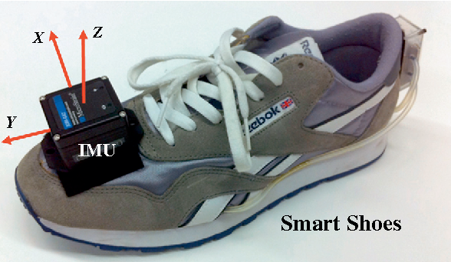
3
Step Length – Zero Velocity Opportunity
Previous researchers benefit from shoe IMU
Opportunity: “zero velocity” when foot on the ground
Calibrate velocity
Constraint the location drift
Bae, Joonbum, and Masayoshi Tomizuka. "A tele-monitoring system for gait rehabilitation with an inertial measurement unit and a shoe-type ground reaction force sensor." Mechatronics 23.6 (2013): 646-651.
Notes:
However, previous researchers have benefited from shoe IMU to do acceleration double integration. Basically they have the zero velocity opportunity when foot is on the ground. This can help calibrate velocity which is a one time integration of acceleration. After calibrating the velocity, they are able to use this more accurate velocity to get location estimation by another integration, and this is much better than directly double integration of acceleration.

Slide 35
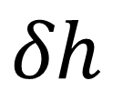
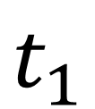
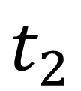
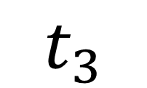
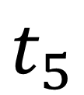

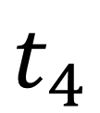
Time
$$t_{1}$$
$$t_{2}$$
$$t_{3}$$
$$t_{4}$$
$$t_{5}$$
Vertical Velocity
$$δh$$
The vertical movement of ear IMU is similar to on foot IMU.
$$l$$
Time
Notes:
There is no zero velocity opportunity for either earphone or smartphone IMUs. However, if we look at the vertical and horizontal velocities separately, there are actually opportunities. The vertical movement of earphone, is actually similar to on foot IMU. Basically when the ear IMU is at the highest or lowest point, the vertical velocity both equals to zero, similar to the point when foot is on the ground for shoe IMUs. With this opportunity, we are able to get an accurate vertical displacement delta h.

Slide 36
How does vertical displacement translate to horizontal step length?

Slide 37
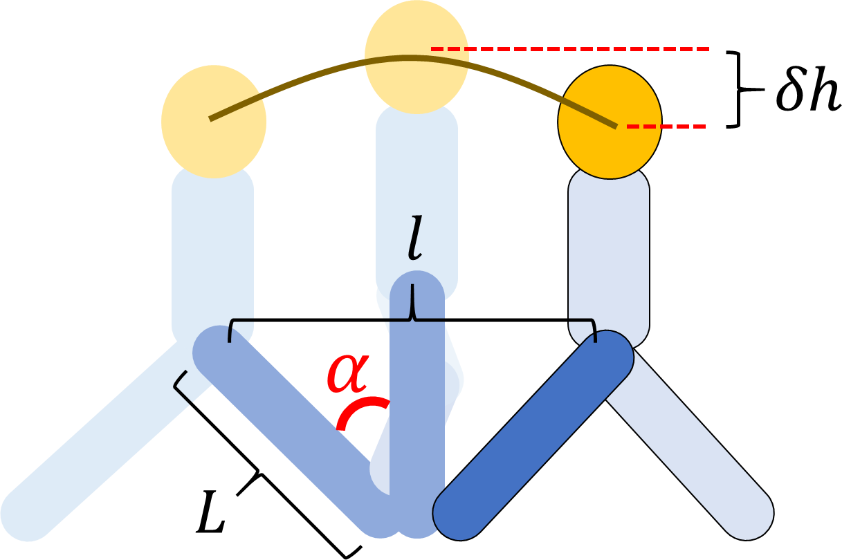
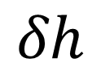
Time
3
Step Length – Inverse Pendulum Model
$$δh$$
Notes:
Our key observation here is the human walking follows the inverse pendulum model. Essentially the earphone moves along a curve with leg length as the radius.

Slide 38
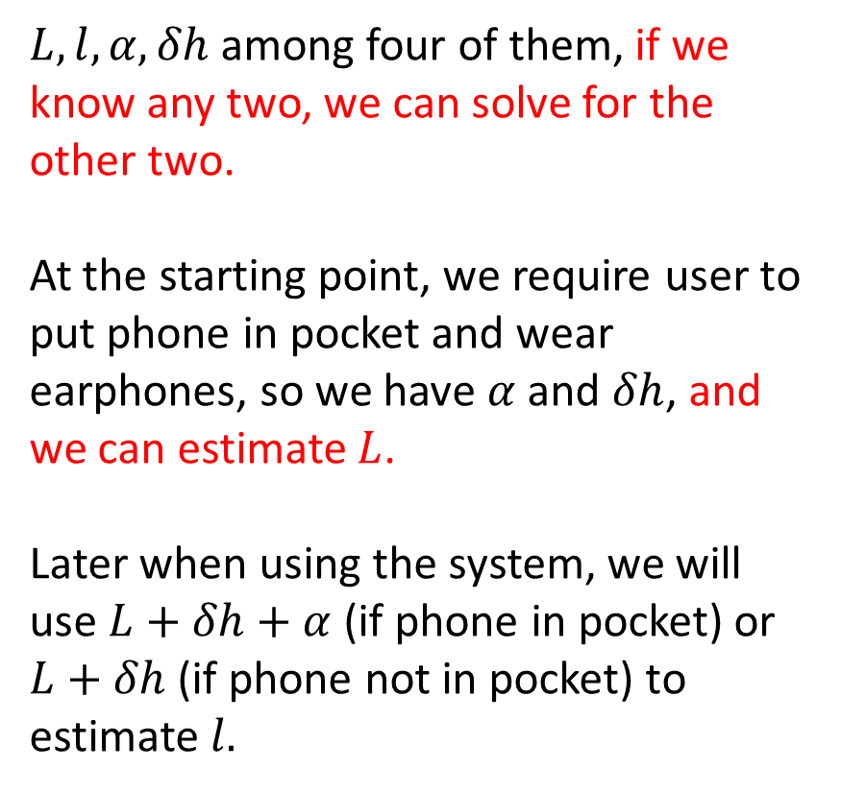
Time
3
Step Length – Inverse Pendulum Model
$L, l, α, δh$ among four of them, if we know any two, we can solve for the other two.
At the starting point, we require user to put phone in pocket and wear earphones, so we have $α$ and $δh$, and we can estimate $L$.
Later when using the system, we will use $L+δh+α$ (if phone in pocket) or $L+δh$ (if phone not in pocket) to estimate $l.$
$$δh$$
Notes:
All the parameters here we have are leg length L, step length l, leg rotation angle alpha and vertical movement delta h. Due to the geometric constraints, if we know two of them, we can solve for the other two,
At the starting point, we require user to put phone in pocket and wear earphones, so we have $α$ from leg rotation and $δh$ from earphone, and then we can estimate $L$. Leg length L will not change.
So this means later when user use the system, we only need one more parameter to get step length. When the phone is in pocket, then we have can measure rotation angle alpha from phone and vertical displacement delta h from earphone, more than enough to find step length. When phone is not in pocket, we will use leg length L and vertical displacement \delta h from earphone to estimate step length.

Slide 39
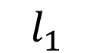
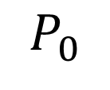



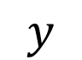

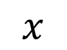
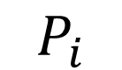
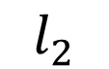
We now have the localization part ready
$$y$$
$$P_{i}$$
1
Step Count
2
$$θ_{3}$$
Walking Direction
$$l_{2}$$
$$θ_{2}$$
3
$$l_{1}$$
Step Length
$$θ_{1}$$
$$P_{0}$$
$$O$$
$$x$$
Notes:
By now, we have all the parameters, step count, walking direction and step length. By treating every step as a vector and connecting them end to end, we get the final location of the user.

Slide 40
Key Research Question:
Design the 3D sound in the earphone so it appears to arrive from the right relative location (w.r.t. the earphone user)
Localization Module
(indoor)
Head Tracking Module
Binaural Audio Module

Slide 41



We need head tracking to ensure the sound comes from a fixed physical direction
Louder & earlier
Softer & later
Notes:
We also use ear IMU for head tracking. This is important because let’s image the user turned her head.

Slide 42
We need head tracking to ensure the sound comes from a fixed physical direction
Louder & earlier
Softer & later
Notes:
To ensure the virtual sound still come from the same physical direction, we actually need to change its direction relative to the head to compensate for the turn. This makes head tracking important.

Slide 43
We need head tracking to ensure the sound comes from a fixed physical direction
3D Gazing
Direction from
earphone IMU
Notes:
To ensure the virtual sound still come from the same physical direction, we actually need to change its direction relative to the head to compensate for the turn. This makes head tracking important.

Slide 44
Key Research Question:
Design the 3D sound in the earphone so it appears to arrive from the right relative location (w.r.t. the earphone user)
Localization Module
(indoor)
Head Tracking Module
Binaural Audio Module

Slide 45

We built the binaural audio on top of localization and head tracking
0°
Azimuth (Horizontal)
Elevation (Vertical)
90°
Horizontal Plane
Notes:
After we get the location and head orientation of the user, we build the binaural audio part on top of them. When the system determines the user is near some audio annotated objects, it will start to play the binaural audio. The binaural audio’s elevation angle and azimuth angle relative to the human head is determined by the relative location of the user and the annotated object, as well as the user’s head orientation.

Slide 46


$$Ch_l=conv\left(IFFT\left(HRTF\left(az, el,l\right)\right), sound source\right)$$
$$Ch_r=conv(IFFT\left(HRTF\left(az,el, r\right)\right), sound source)$$
Notes:
Specifically, we used a general head related transfer function to render binaural audio. The head related transfer function depicts how the human head act as a filter affect the sound. It takes elevation angle and azimuth angle, as well as left or right ear as input. By convolving the time domain representation of head related transfer function with annotation sound source audio, we generated the binaural audio, and play it through the user’s earphone. By now, we have a crude system ready.

Slide 47
$$Ch_l=conv\left(IFFT\left(HRTF\left(az, el,l\right)\right), sound source\right)$$
$$Ch_r=conv(IFFT\left(HRTF\left(az,el, r\right)\right), sound source)$$
By now, we have a crude system ready
Notes:
Specifically, we used a general head related transfer function to render binaural audio. The head related transfer function depicts how the human head act as a filter affect the sound. It takes elevation angle and azimuth angle, as well as left or right ear as input, by convolving the time domain representation of head related transfer function with annotation sound source audio, we generated the binaural audio, and play it through the user’s earphone. By now, we have a crude system ready.

Slide 48
But…any kind of dead reckoning will drift, a better algorithm can only slower the drift.

Slide 49
Key intuition: use human’s binaural ability to calibrate
Actual Object Direction
Binaural Sound Direction
Est. User Location
Actual User Location
Opportunistic Recalibration: Direction Calibration
Notes:
We need to find opportunity to calibrate. Let’s consider the following scenario. When the user is looking at the painting, the red arrow is the direction binaural audio should come from. However, the user feels the binaural audio comes from the direction of the green arrow. This means, the system’s location estimation has drifted and there is a need for calibration. Instead of thinking the user at her actual location, the system thinks the user is to the left of the actual location in this scenario. To calibrate, the user just needs to look at the paining, and press a calibration button on the earphone, or simply say “calibrate me” using voices assistant function on earphones. By reading out the head orientation from head IMU, the system will know in which direction the user is relative to the paining. In other words, the user location is calibrated to the direction of the red arrow, but what the distance is between user and the painting is not known yet.

Slide 50

Opportunistic Recalibration: Distance Calibration
Notes:
To calibrate the distance between user and the painting, we ask user to first look at the painting, and then look at ground projection point of the painting. The system will record the two angles theta 1 and theta 2 in the figure. Assume the high of user’s eye in already known by the system, we can then use triangulation to estimate the distance D.

Slide 51
By now, we’ve covered the system design of Ear-AR.

Slide 52
Opportunistic Recalibration
Localization Module
Head Tracking Module
Binaural Audio Module
End-to-end Ear-AR System
Notes:
Ear-AR has the localization module, head tracking module and binaural audio module. We also use binaural audio as an opportunistic calibration opportunity. Upon these components, we build the end-to-end Ear-AR system.

Slide 53



Ear-AR: System Demo
Ear-AR: Evaluation
This book was first sold in …
This art piece is by Picasso
Notes:
We implemented Ear-AR on beats earphones, a smart phone and a wireless IMU, and evaluated it in our building lobby and lab. We placed a number of audio annotations on physical objects in the environment and asked the user to retrieve the audio annotation from a specific object as they walked around.

Slide 54

Ear-AR: Performance
Error <5m for every 100m of walking without calibration
Notes:
Now let me show the evaluation results. First, let me show the dead reckoning result. The dead reckoning error for Ear-AR is much less compared with past works. Ear-AR’s localization error is within 5 meters for ever 100 meters of walking without calibration, and will be better if users do opportunistic calibration while using the system.

Slide 55


Ear-AR: Performance
In 80% cases, OIE = 0
In rest 20% cases, median OIE $≈$ 2.5m
Notes:
Then let me introduce the metric of object identification error, OIE. User can retrieve the information from a wrong object due to confusion. OIE is the distance between the object the user wanted to retrieve and the object the user actually retrieved from. The results are promising. In 80% of cases, the user is able to identify the correct object. In 20% cases where user identified the wrong object, average OIE is around 2.5m.

Slide 56
Conclusion
We present Ear-AR, a practical solution for indoor acoustic augmented reality.
Jointly use ear IMU and phone IMU to do better dead reckoning.
Identify human’s ability to perceive binaural sound as calibration opportunities.
We built Ear-AR on off the shelf mobile devices and evaluated it in real world settings.
Results are promising.
Notes:
Finally, let me use this slide to conclude my presentation…. For more details, please refer to our paper.

Slide 57





More details in the paper …
Thanks.
Zhijian
Yu-Lin
Sheng
Romit

